Slide 1


Slide 2
Database Normalization
Designing a Proper Database

Slide 3
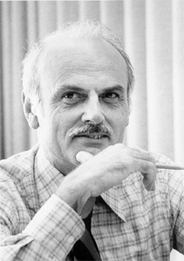
Database Normalization
Structuring database tables such that
Redundancy is minimized
Data integrity is maximized
Edgar F Codd: a pioneer in databases
Proposed “1st Normal Form” in 1970
Went on to propose many more increasingly strict normalized forms

Slide 4
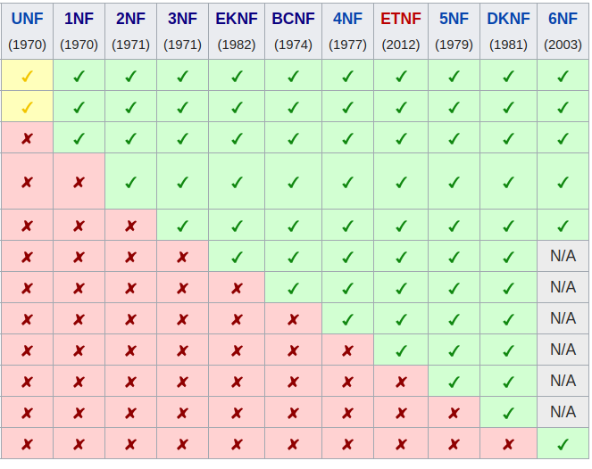
Database Normalization
Most famous Normal Form is BCNF: Boyce-Codd Normal Form
We will be focusing on
1st Normal Form
2nd Normal Form
3rd Normal Form & BCNF
BCNF and 3NF are equivalent in the presence of a single column key (surrogate or synthetic key, most tables today)

Slide 5
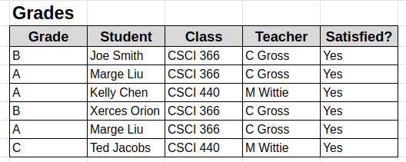
Our Database
Consider the following simple database
This database is not normalized
Let’s fix it

Slide 6
1st Normal Form
To Be in 1NF, there must be a key
Let’s review the concepts and terminology around keys

Slide 7
What Are Keys?
A key is a set of attributes (columns) that uniquely determine a row
The literature uses the term superkey, which makes it sound cool
In a relation with no duplicates, the set of all columns is a superkey
A candidate key (aka minimal superkey) is a key from which no attributes can be removed without causing it to no longer be a key
The primary key is the candidate key used to identify rows in the relation
In practice, an ID column is typically added to a relation to be the primary key. This is sometimes called a surrogate or synthetic key.

Slide 8
1st Normal Form
So, do we have a key in this relation?

Slide 9
1st Normal Form
So, do we have a key in this relation?
No. There are duplicate rows, so no set of columns uniquely identifies a row.

Slide 10
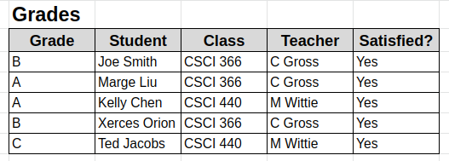
1st Normal Form
We need to eliminate this duplicate data to get into 1NF
Most real world databases there will be a surrogate key column, making the database trivially 1NF (Problem?)

Slide 11
1st Normal Form
NB: Students can take multiple classes.
We do not have a single column key here. So, what is our key?

Slide 12
1st Normal Form
NB: Students can take multiple classes.
We do not have a single column key here. So, what is our key?
Student + Class Uniquely determines a row so {Student, Class} is our key

Slide 13
2nd Normal Form
To achieve 2NF, all data must depend on the entire key
Again, this is trivially true with surrogate keys
You can start to see why surrogate keys became a standard

Slide 14
2nd Normal Form
We know the key is {Student, Class}
Is there any data that depends only on part of that key?

Slide 15
2nd Normal Form
Teacher depends only on Class!
To fix this, we need to pull Teacher data out to a separate table

Slide 16
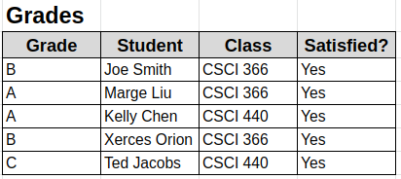
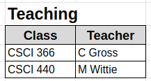
2nd Normal Form
We are now in 2NF
Note that C Gross and M Wittie only appear once
Data redundancy has been removed
Easier to avoid update errors

Slide 17
3rd Normal Form
We can do better! There is still redundant data here!
3NF demands that all data depend only on the key
What data here that does not depend on the key?

Slide 18
3rd Normal Form
Satisfied does not depend on the key
Rather, it depends on the Grade column
OK, so let’s pull that out as well

Slide 19
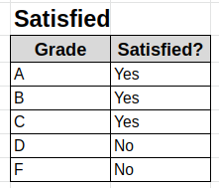
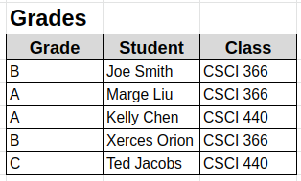
3rd Normal Form
Satisfied does not depend on the key
Rather, it depends on the Grade column
OK, so let’s pull that out as well!

Slide 20
3rd Normal Form
We now have a database in 3NF
It is also in BCNF
3NF typically satisfies BCNF, especially with surrogate keys

Slide 21
3rd Normal Form
What have we accomplished?
Data redundancy has been minimized
Update complexity has been minimized
E.g. it is easy to change “Satisfied” criteria now

Slide 22
Normal Form Summary
Each non-key column in a relation depends on
The key (1NF)
The whole key (2NF)
And nothing but the key (3NF/BCNF)
So help me Cobb ;)
In the presence of a surrogate key, things become pretty obvious
In industry, there is always a surrogate key
What’s The General Principle?

Slide 23
Normal Form Summary
Each non-key column in a relation depends on
The key (1NF)
The whole key (2NF)
And nothing but the key (3NF/BCNF)
So help me Cobb ;)
In the presence of a surrogate key, things become pretty obvious
In industry, there is always a surrogate key
What’s The General Principle?
Don’t Repeat Yourself! (DRY)

Slide 24
Denormalizing
We’ve talked about how to normalize a database
Would you ever want to denormalize a database?

Slide 25
Denormalizing
Yep! (Careful talking with the DBA though!)
Performance is the biggest reason to denormalize data
Say you wanted to find all students who didn’t pass a class. The denormalized table would be faster to work with
No need to merge two tables together, just a simple filter

Slide 26
Denormalizing
Denormalization is basically caching at the database level
“There are only two hard things in Computer Science: cache invalidation and naming things.” -- Phil Karlton
Be careful, but judicious denormalization can be a big win!

